Slide 1




Safety Reporting Reference Model
Optimizing Global Safety Reporting in Clinical Trials using Local Laws
Steven Beales,
SVP, Scientific and Regulatory
WCG Clinical
Notes:
Thank you all for coming here today. Only the best people in any field take the time to come so far for a conference like this.
You’re going to enjoy the time we spend together this afternoon. I will share with you some of the most important ideas that have ever been discovered in Global Safety Reporting.
I’ll be introducing you to the Safety Reporting Reference Model and the AI that’s used to operationalize and maintain it.

Slide 2
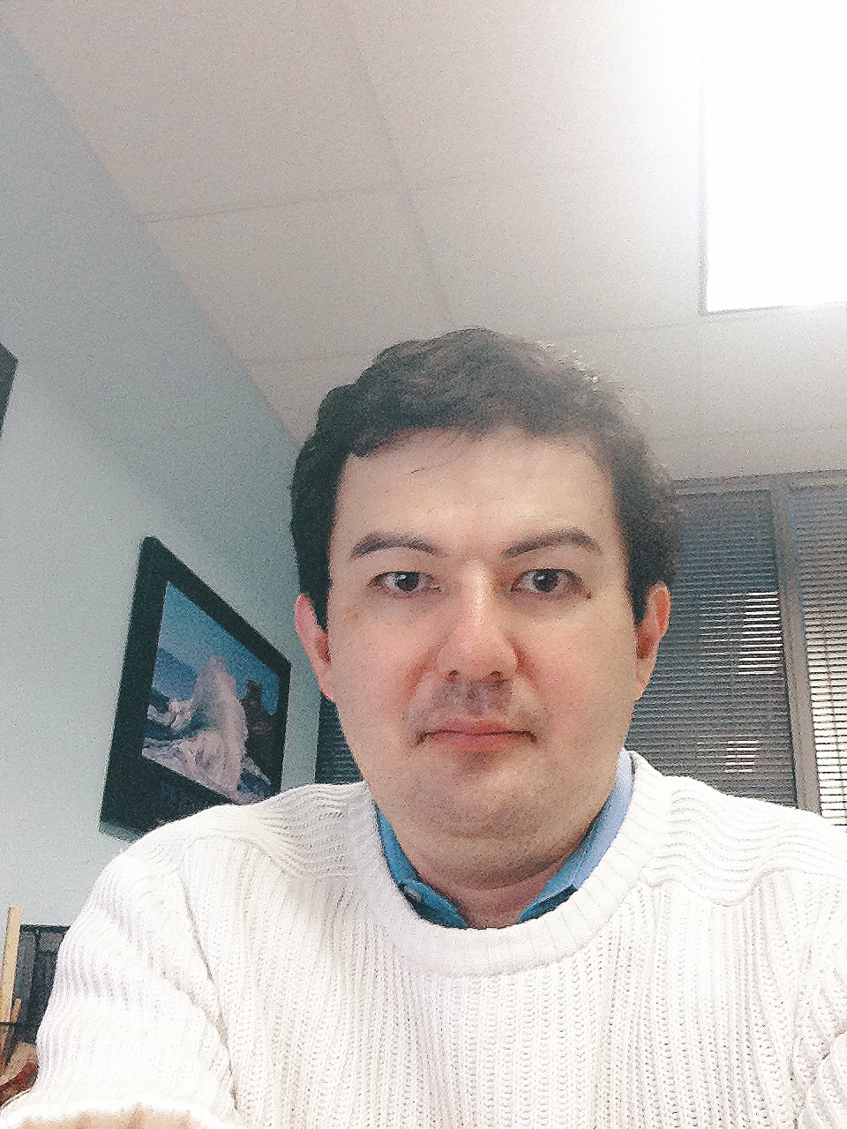
Harmonizing Global Safety Reporting 10 year adventure
Excuse to use 10 year old headshot!
Steven Beales
SVP, Scientific and Regulatory, WCG
sbeales@wcgclinical.com
Notes:
I’m Steven Beales. If you struggle with my accent, it’s because I’ve spent half my life in the UK and half in the US. Every day I wake up not knowing which government is going to embarrass me more. This week, it’s the UK.
It will be exactly 10 years ago next Tuesday – 1st World Patient Safety Day - that I began working on technology to harmonize global safety reporting.
1 of the largest Pharma companies in Europe invited me to help solve an EMA infringement procedure.
Do you remember how different technology was 10 years ago? Netflix delivered DVDs in envelopes. We all had blackberries with 3 inch screens and buttons.
Today, I will take you through our 10 year journey through the pragmatic application of different types of AI – rules-based, natural language processing, machine learning – to solve real world problems on a global scale.

Slide 3




Regulatory Challenges with Global Safety Reporting
No Standards
Unclear Regulations
Conflicting Interpretations
Notes:
My first Meeting with country affiliates at the largest pharmas opened my eyes to the challenges of Global Safety Reporting.
Were there any standards for distributing safety reports globally to investigators, ethics committees, and regulatory authorities? - No global standards.
Does each country uniquely regulate when and how interested parties receive safety reports? – Yes and later when we catalogued the variations, we found over 40 different approaches.
Do biopharmas interpret local country rules themselves to decide what safety information should be distributed in a given country? - Yes, every biopharma defines what safety reports they will generate and how they will aggregate that information.

Slide 4
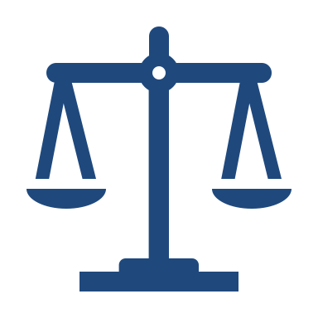

Consequences of Lack of Global Harmonization
Regulatory Repercussions
Fractured Accountability
Increased Costs
Notes:
The No.1 safety reporting problem for Sponsors has become this lack of global harmonization as clinical research becomes more global.
The No 2 problem is the fear of regulatory repercussions and changing regulations, because rules and practices vary from country to country.
It is difficult to understand in each country the role the Sponsor plays in coordination with the regulatory authority, the investigators, the ethics committees or DSMBs in sharing patient safety responsibilities.

Slide 5



Future of Increasing Clinical Trial Complexity
Multiple Partners
Advanced Therapies
Combination Studies
Notes:
And it will only get more complex …
Large clinical trials are magnifying the underlying problems we always faced in managing global teams and partners across multiple countries and affiliates.
27% of clinical trials are oncology-focused which generate 3-5x more severe ADRs than other therapeutic areas.
We’ve seen a 571% increase in SUSAR volume over 2 years at a Japanese Pharma who moved their portfolio towards oncology.

Slide 6



Pressure of Clinical Trial Site Burdens
Too Many Reports
Duplicate Reports
Overly Time-consuming
Too Many Websites
Useful Information Hidden
Notes:
Meanwhiles sites are overwhelmed with over-reported and cross-reported safety reports due to this “brute-force” distribution.
Many companies still distribute all safety reports to all Sites and Ethics Committees due to a literal interpretation of GCP instead of observing local laws.
80% of sites receive more than 20 SUSARs per month and take an average of 2 hours per SUSAR to process.
20% have refused to process a SUSAR because it was an over-distribution. We get at least 1 call every month from a site in US that asks “Why can’t sponsors get their act together and stop sending us SUSARs where there is no causal relationship to the drug?”
This is a current reality that will be all too familiar to most of you. But it doesn’t have to be that way.

Slide 7

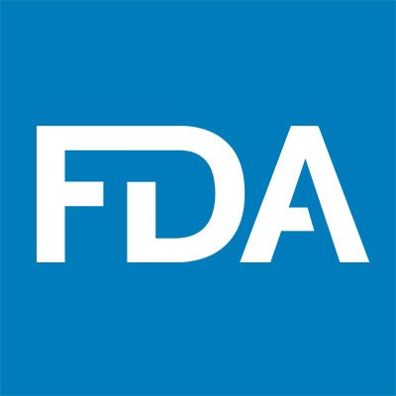

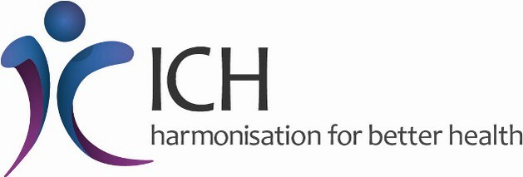

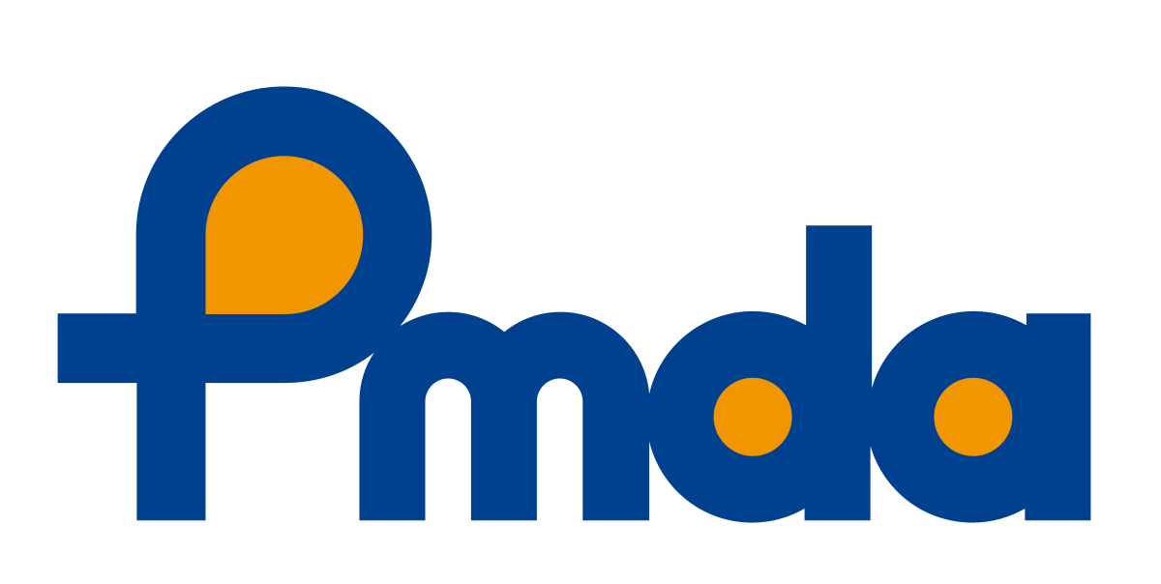
Safety Reporting Harmonization Working Group
Top 1 US Pharma
Top 1 EU Pharma
Top 1 US IRB
Top 1 US CRO
Top 2 Japan Pharma
Top 3 US Biotech
Notes:
Earlier this year, I was excited to be asked to chair the Safety Reporting Harmonization Working Group with experts from many of the leading companies in our industry.
Our mission is to -
Drive global harmonization in reporting rules for Investigators and Ethics Committees by creating a reference model of global safety reporting rules
Develop models for “niche” countries where regulations are unknown so as not to delay site or study activation
Understand the end to end process flows of Safety Reporting between Patients, Investigators, Sponsor, CRO, Regulatory Authority, and Ethics Committees

Slide 8



Safety Reporting Reference Model
125 Countries
7800 Country Rules
Quarterly Updates
Notes:
We are pleased to release our first working group deliverable in October - the safety reporting reference model version 1.0 for 125 countries and 63 different types of local rules.
The model contains over 7800 country rules and I’d like to thank the companies who donated and harmonized their interpretations over the last few months. This has enabled us to reduce every rule to a picklist of 3-5 options.
We will be publishing updates to this model every 3 months.

Slide 9



Precision Safety Reporting
Right Information
Right Time
Right Person
Notes:
When building the reference model our vision was a system that would send the right safety report to the right person at the right time anywhere in the world according to local law.
We catalogued all the variations in local laws that affect safety reporting and stored them in a rules database that could be used to power a safety reporting system.

Slide 10

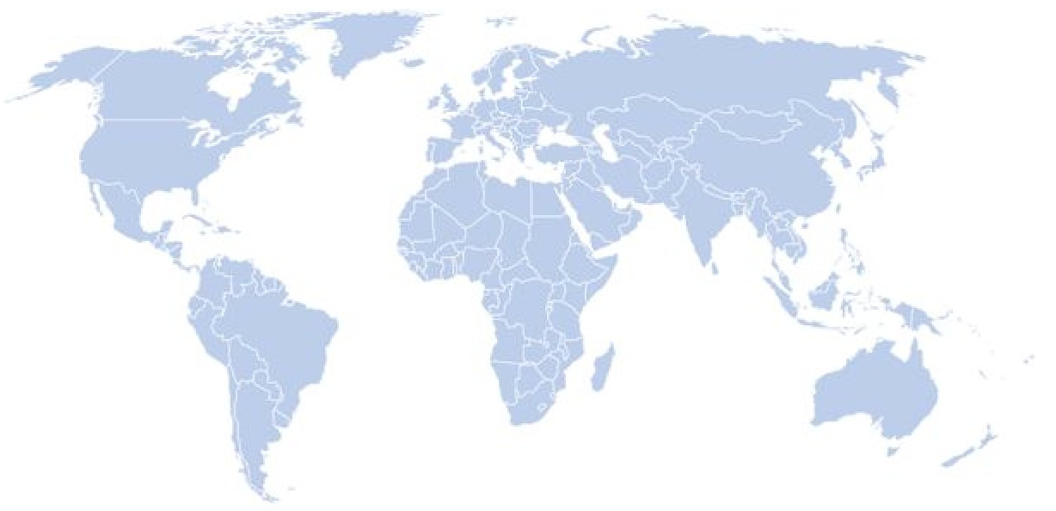

Safety Reporting Artificial Intelligence
Precision
Distribution
75k Safety
Reports
100m Safety
Notifications
Safety
Reference
Model
Notes:
3 of our 6 working group members have launched dynamic data driven and rules-based Artificial Intelligences that use the safety reference model to power precision distribution to sites, ECs and RAs in over 100 countries.
The AI considers causality, unblinding, RSI, cross reporting, country, site and EC rules to make its reporting decisions.
By end of 2019, these systems will have sent over 75k SUSARs and over 100m safety letters.

Slide 11

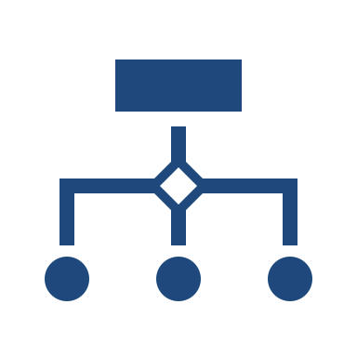

Safety Reporting Regulatory Intelligence
Natural Language Processing
Text Classification
Text Summarization
Notes:
In order to keep up with the burden of maintaining our model, we have begun using Natural Language Processing to parse the main regulatory sources of information and guidance in order to summarize and classify the information.
The ability to extract the most important 6 lines, key words and topics from guidance has been invaluable in cutting the time to support this activity by over 80%.
WCG owns FDA News and CenterWatch so has a huge library of articles to text mine.

Slide 12

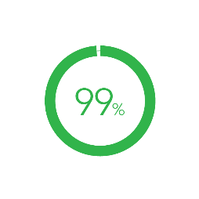
Big Data – 100s of Millions of Records per Year
Costs
Avoided
Sites in Compliance
Reduction in Site Burden
175 - 450k
per trial
10 hours
per week
Notes:
Already we have a huge dataset to mine that will keep growing.
Some initial results include 175k vs basic technology and 450k vs manual distribution.
99% of sites have trained active users in system and receiving delivery.
Average reduction in Safety Reports per week = 5 resulting in 10 hours saved per site per week.
Future ideas – WCG has the Inspire Patient Forums to compare incidence of unexpected adverse reactions against clinical trial information.

Slide 13


Outcomes – Feeling Safe about Safety
Quality
Oversight
Traceability
Compliance
Notes:
Some outcomes we are already seeing at our founding biopharmas
Absence of compliance findings –
The model prevents non-compliant activities such as distributing unapproved versions of RSI to investigators within IBs
The model ensures that a biopharma has traceability for unblinded distribution to local ECs.

Slide 14

Site Experience and Testimonials
“System is seriously phenomenal compared to other sponsor’s pharmacovigilance systems”
Notes:
US academic site

Slide 15
Benefits of Right-Sizing Safety Reporting
Improve Patient Safety
Make Sites Happier
Pass Inspections
Avoid Costs
Notes:
By eliminating over-distribution of safety reports, a sponsor may transform their clinical operations –
improve patient safety
reduce site burden
improve compliance
save money.

Slide 16

Time For Action
Notes:
Change is never painful, only resistance to change is painful. Join us in building the safety reporting reference model. May all your future safety reporting be accurate and precise.

Slide 17
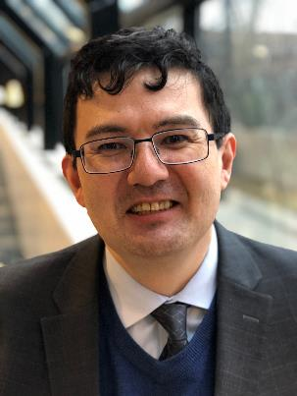
Steven Beales
SVP, Scientific and Regulatory, WCG
sbeales@wcgclinical.com

Slide 18
Ask Big Questions

Slide 19
Thank You

